Slide 1
Case Study: E/M Upcoding
Unsupervised Anomaly Detection

Slide 2
What is Unsupervised Anomaly Detection?

Slide 3
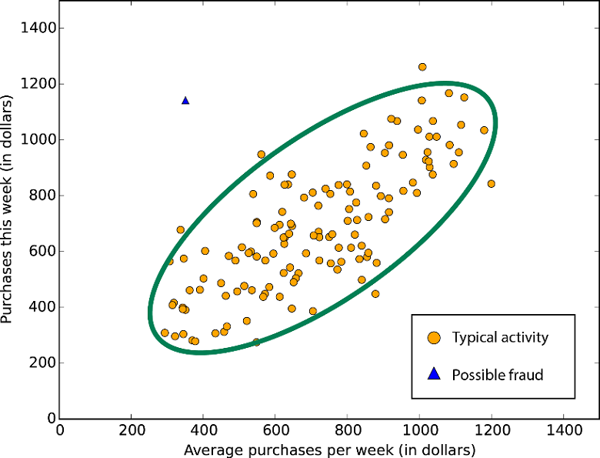
Unsupervised Anomaly Detection
Notes:
Anomaly Detection: Identification of events that do not conform to expected pattern
Unsupervised: Unlabeled Data!
X axis: Average purchases per week
Y axis: Purchases this week
Orange dots: typical activity, correlation is basically 1:1
Blue Triangle: possible fraud
Unsupervised data so we don’t know if it’s fraud, but possible
In our case study, the goal will be to identify all of these blue triangles, data points that look weird and non-conforming to the general pattern so that we can focus and dig deeper into those individual cases.

Slide 4
Case Study: E/M Upcoding

Slide 5
Evaluation and Management (E/M) Codes
Very Common
Medicare pays for over 200 million office visits a year
$32.3 billion in payments in 2010
Types of Services
Consultation
Review of illness history
Physical Exam
Five Different Levels
Providers bill for different levels of intensity
Higher intensity = Higher reimbursement
Possible area of abuse!
Upcoding: Billing for services at a higher intensity than rendered
Notes:
--Very common (don’t need to spend time on actual numbers)
--Go through types of services
--Why is this interesting to us – there are 5 different levels of E/M codes in an office visit.
Templates in EMR system
Aggressive Coders

Slide 6

Evaluation and management services are visits performed by physicians to assess and manage a beneficiary’s health. Medicare paid $32.3 billion for E/M services in 2010. In total, Medicare inappropriately paid $6.7 billion for claims for E/M services in 2010 that were a result of incorrectly coded and/or lacking documentation, representing 21 percent of Medicare payments for E/M services that year.
Department of Human and Health Services: Office of Inspector General
Improper Payments For Evaluation and Management Services Cost Medicare Billions in 2010

Slide 7
Analysis!

Slide 8
Limitations
Not Perfect
Inherent member selection bias.
What constitutes as an anomaly?

